Slide 1
STUDENT ALUMNI PORTAL MANAGEMENT SYSTEM

Slide 2
Abstract:
The Objective of this Application is to allow old and new student of a university or college to communication with each other .this allows student to know about each other their current and activities.

Slide 3
Existing System:
Many Institution ,college and university maintain the information manually about present and past student. This does not allow efficient data management and retrieval process .A student willing to get information about others has to approach the college and obtain the details .Often the information may not be available and misleading

Slide 4
PROPOSED SYSTEM:
This application allows student to register and then search the data based on different criteria Also it has the benefit of having a centralized database and up to data information .A user can easily obtain information about other registered students.

Slide 5
MODULE DESCRIPTION:
After careful analysis the system has been identified to have the following time scheduler modules:
Users of the System :
Administrator
Event manager
Student/Alumni

Slide 6
MODULES OF THE SYSTEM
Administrator
Events Manager
Student & alumni
Authentication

Slide 7
FUNCTIONAL REQUIREMENTS OF THE PROJECT:
Administrator:
The administrator is responsible for maintaining information of student.
Event Manager Module:
This module maintains the information about various event that are conducted by
various colleges and universities.
Alumni & student Module:
They can logon into their account and can send mails, post query, update their
profile and even search for other student details.
Authentication :
login
student registration
View students
Change password
View profile
logout

Slide 8
SOFTWARE REQUIREMENTS:
Operating System : Windows XP/2003 or Linux
User Interface : HTML, CSS
Client-side Scripting : JavaScript
Programming Language : Java, Servlets, jsp
IDE/Workbench : My Eclipse 8.6
Database : Oracle 10g
Server Deployment : Tomcat 6.x
Browser : IE, Mozilla, etc

Slide 9
HARDWARE REQUIREMENTS
Processor : core 2 duo
Hard Disk : 160GB
RAM : 1GB or more
Notes:
Processor : core 2 duo
Hard Disk : 160GB
RAM : 1GB or more

Slide 10
FEASIBILITY REPORT

Slide 11
TECHNICAL FEASIBILITY:
Evaluating the technical feasibility is the trickiest part of a feasibility study. This is because, at this point in time, not too many detailed design of the system, making it difficult to access issues like performance, costs on (on account of the kind of technology to be deployed) etc. A number of issues have to be considered while doing a technical analysis.
Understand the different technologies involved in the proposed system
Find out whether the organization currently possesses the required technologies
OPERATIONAL FEASIBILITY:
Proposed projects are beneficial only if they can be turned into information systems that will meet the organizations operating requirements. Simply stated, this test of feasibility asks if the system will work when it is developed and installed.
ECONOMIC FEASIBILITY:
Economic feasibility attempts 2 weigh the costs of developing and implementing a new system, against the benefits that would accrue from having the new system in place. This feasibility study gives the top management the economic justification for the new system.

Slide 12
DATA FLOW DIAGRAMS

Slide 13
A graphical tool used to describe and analyze the moment of data through a system manual or automated including the process, stores of data, and delays in the system. Data Flow Diagrams are the central tool and the basis from which other components are developed. The transformation of data from input to output, through processes, may be described logically and independently of the physical components associated with the system. The DFD is also know as a data flow graph or a bubble chart.
The Basic Notation used to create a DFD’s are as follows:
Dataflow: Data move in a specific direction from an origin to a destination.
2. Process: People, procedures, or devices that use or produce (Transform) Data. The physical component is not identified.
3. Source: External sources or destination of data, which may be People, programs, organizations or other entities.
4. Data Store: Here data are stored or referenced by a process in the System.

Slide 14
CONTEXT LEVEL DATA FLOW DIAGRAM
Notes:
Processor : core 2 duo
Hard Disk : 160GB
RAM : 1GB or more

Slide 15
Notes:
Processor : core 2 duo
Hard Disk : 160GB
RAM : 1GB or more

Slide 16
Notes:
Processor : core 2 duo
Hard Disk : 160GB
RAM : 1GB or more

Slide 17
LEVEL1 DATA FLOW DIAGRAM FOR ADMIN
Notes:
Processor : core 2 duo
Hard Disk : 160GB
RAM : 1GB or more

Slide 18
LEVEL 2 DATA FLOW DIAGRAM:
LEVEL 3 DATA FLOW DIAGRAM:
Notes:
Processor : core 2 duo
Hard Disk : 160GB
RAM : 1GB or more

Slide 19
USER:
LEVEL1 DATA FLOW DIAGRAM FOR USER
LEVEL2 DATA FLOW DIAGRAM:
LEVEL3 DATA FLOW DIAGRAM:
Notes:
Processor : core 2 duo
Hard Disk : 160GB
RAM : 1GB or more

Slide 20
SDLC METHODOLOGIES

Slide 21
This document play a vital role in the development of life cycle (SDLC) as it describes the complete requirement of the system. It means for use by developers and will be the basic during testing phase. Any changes made to the requirements in the future will have to go through formal change approval process.
SPIRAL MODEL was defined by Barry Boehm in his 1988 article, “A spiral Model of Software Development and Enhancement. This model was not the first model to discuss iterative development, but it was the first model to explain why the iteration models.
The steps for Spiral Model can be generalized as follows:
The new system requirements are defined in as much details as possible. This usually involves interviewing a number of users representing all the external or internal users and other aspects of the existing system.
A preliminary design is created for the new system.
A first prototype of the new system is constructed from the preliminary design. This is usually a scaled-down system, and represents an approximation of the characteristics of the final product.

Slide 22
A second prototype is evolved by a fourfold procedure:
Evaluating the first prototype in terms of its strengths, weakness, and risks.
Defining the requirements of the second prototype.
Planning an designing the second prototype.
Constructing and testing the second prototype.
Risk factors might involved development cost overruns, operating-cost miscalculation, or any other factor that could, in the customer’s judgment, result in a less-than-satisfactory final product.
The existing prototype is evaluated in the same manner as was the previous prototype, and if necessary, another prototype is developed from it according to the fourfold procedure outlined above.
The preceding steps are iterated until the customer is satisfied that the refined prototype represents the final product desired.
The final system is constructed, based on the refined prototype.
The final system is thoroughly evaluated and tested. Routine maintenance is carried on a continuing basis to prevent large scale failures and to minimize down time.

Slide 23
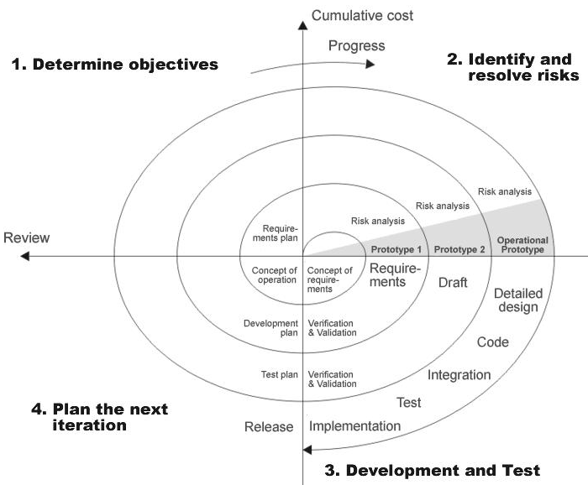
THE FOLLOWING DIAGRAM SHOWS HOW A SPIRAL MODEL ACTS LIKE:

Slide 24
ADVANTAGES OF SPIRAL MODEL:
Estimates(i.e. budget, schedule etc .) become more realistic as work progresses, because important issues discovered earlier.
It is more able to cope with the changes that are software development generally entails.
Software engineers can get their hands in and start working on the core of a project earlier.

Slide 25
E-R DIAGRAM

Slide 26
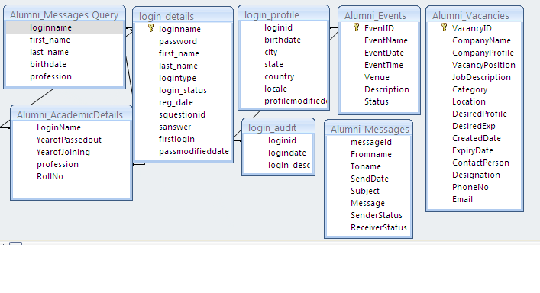
Notes:
Processor : core 2 duo
Hard Disk : 160GB
RAM : 1GB or more

Slide 27
UML DIAGRAMS

Slide 28
UNIFIED MODELING LANGUAGE DIAGRAMS
The unified modeling language allows the software engineer to express an analysis model using the modeling notation that is governed by a set of syntactic semantic and pragmatic rules.
USER MODEL VIEW
This view represents the system from the users perspective.
The analysis representation describes a usage scenario from the end-users perspective.
STRUCTURAL MODEL VIEW
In this model the data and functionality are arrived from inside the system.
This model view models the static structures.
BEHAVIORAL MODEL VIEW
It represents the dynamic of behavioral as parts of the system, depicting the interactions of collection between various structural elements described in the user model and structural model view.
IMPLEMENTATION MODEL VIEW
In this the structural and behavioral as parts of the system are represented as they are to be built.
ENVIRONMENTAL MODEL VIEW
In this the structural and behavioral aspects of the environment in which the system is to be implemented are represented.

Slide 29
CLASS DIAGRAMS

Slide 30
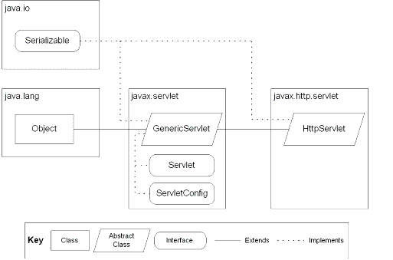
CLASS DIAGRAM
JSP: Implicit Objects

Slide 31
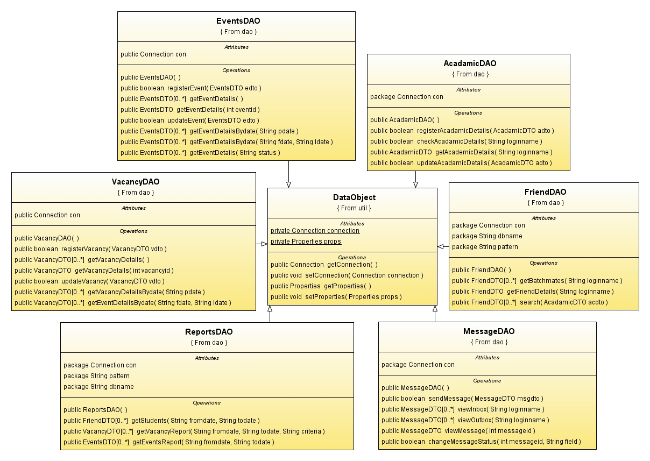
Notes:
Processor : core 2 duo
Hard Disk : 160GB
RAM : 1GB or more

Slide 32
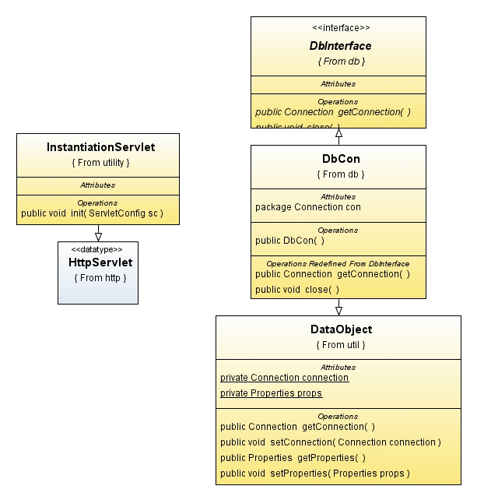
Notes:
Processor : core 2 duo
Hard Disk : 160GB
RAM : 1GB or more

Slide 33
USE CASE DIAGRAMS

Slide 34
USE-CASE DIAGRAM
Notes:
Processor : core 2 duo
Hard Disk : 160GB
RAM : 1GB or more

Slide 35
ADMIN USE-CASE DIAGRAM
Notes:
Processor : core 2 duo
Hard Disk : 160GB
RAM : 1GB or more

Slide 36
USER USE-CASE DIAGRAM
Notes:
Processor : core 2 duo
Hard Disk : 160GB
RAM : 1GB or more

Slide 37
SEQUENCE DIAGRAMS

Slide 38
ADMIN SEQUENCE DIAGRAM FOR ALUMN
Notes:
Processor : core 2 duo
Hard Disk : 160GB
RAM : 1GB or more

Slide 39
USER SEQUENCE DIAGRAM FOR ALUMN
Notes:
Processor : core 2 duo
Hard Disk : 160GB
RAM : 1GB or more

Slide 40
ACTIVITY DIAGRAMS

Slide 41
Notes:
Processor : core 2 duo
Hard Disk : 160GB
RAM : 1GB or more

Slide 42
Notes:
Processor : core 2 duo
Hard Disk : 160GB
RAM : 1GB or more

Slide 43
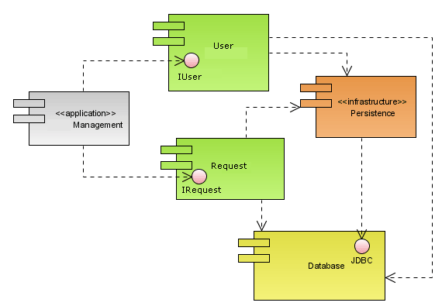
COMPONENT DIAGRAM :
Notes:
Processor : core 2 duo
Hard Disk : 160GB
RAM : 1GB or more

Slide 44
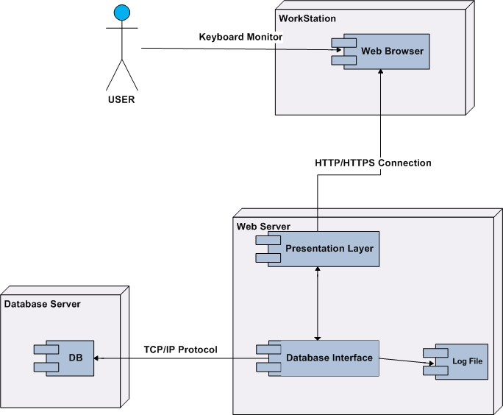
DEPLOYMENT DIAGRAM
Notes:
Processor : core 2 duo
Hard Disk : 160GB
RAM : 1GB or more

